Slide 1

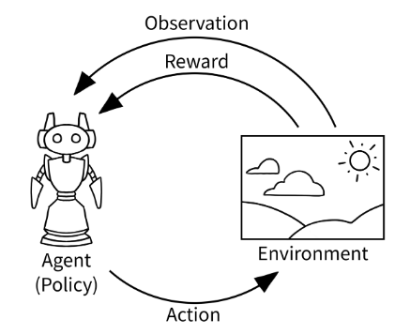

CSC485B Machine Learning for Robotics
SUNY Plattsburgh
Dr. Ned Lecky
Class 19: Reinforcement Learning

Slide 2
What Is Reinforcement Learning?
Really more of a programming paradigm
Imagine we have an environment (which can be real or simulated)
The environment changes based on Actions taken by an Agent
Maybe the agent moves within the environment
Or maybe something changes in the environment

Slide 3
The Learning Part
We take actions based on some primitive algorithm which we call a policy
We observe how the environment changes and evaluate whether we like or dislike what is happening (a “reward” function)
Then, we try to improve the policy over time

Slide 4
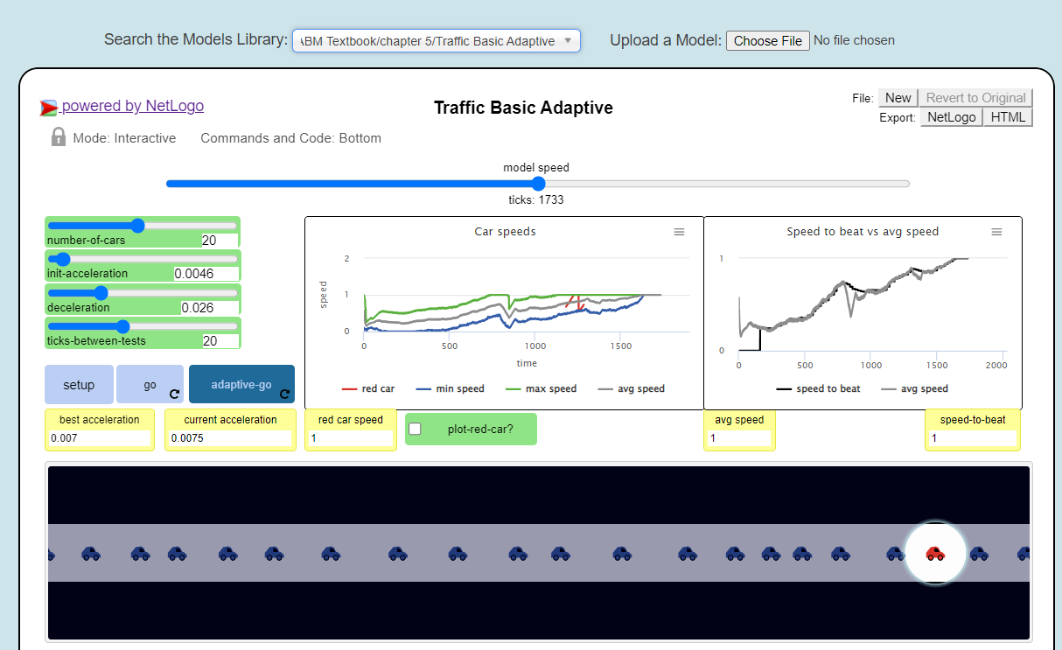
Simple Learning in NetLogo
This is still ML!
http://www.netlogoweb.org/launch#http://www.netlogoweb.org/assets/modelslib/IABM%20Textbook/chapter%205/Traffic%20Basic%20Adaptive.nlogo

Slide 5
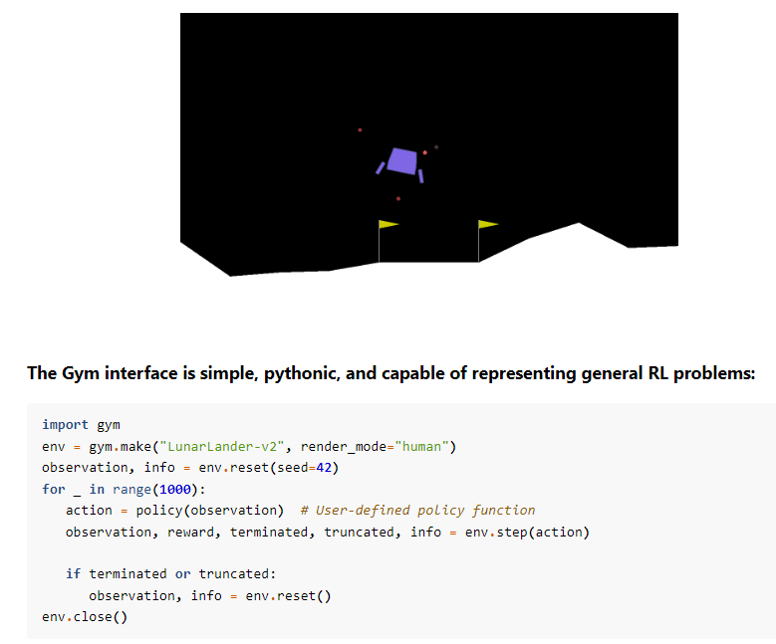
Gym Library
https://www.gymlibrary.dev/
Quite a few built-in environments for testing
Let’s take a look at what’s available

Slide 6
Gym in Colab
Google has a nice overview
https://colab.research.google.com/drive/1flu31ulJlgiRL1dnN2ir8wGh9p7Zij2t
Which doesn’t quite work……..

Slide 7
Geron Chapter 18
Nice RL walkthrough with use of Gym
https://github.com/ageron/handson-ml3/blob/main/18_reinforcement_learning.ipynb

